Slide 1



Python Tsunami
– June 7th-9th –

Slide 2
What else?
The future of the Tsunami:
- Divided into 2: intro and advanced
Machine Learning in Python
- Future course at HeaDS
Community:
NNF Computational Biology Network

Slide 3






Future of the Tsunami
Currently

Slide 4


Future of the Tsunami
Currently
Future
Intro
Advanced

Slide 5

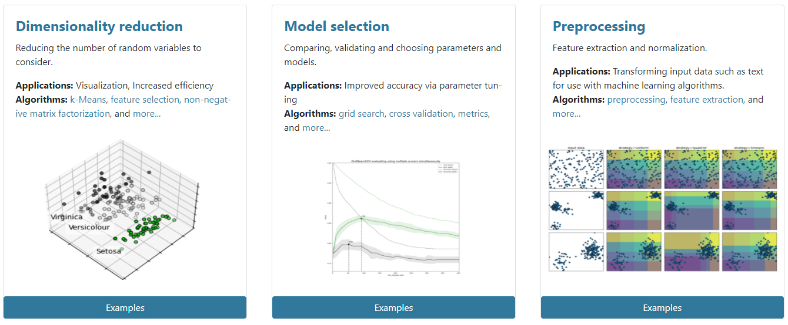
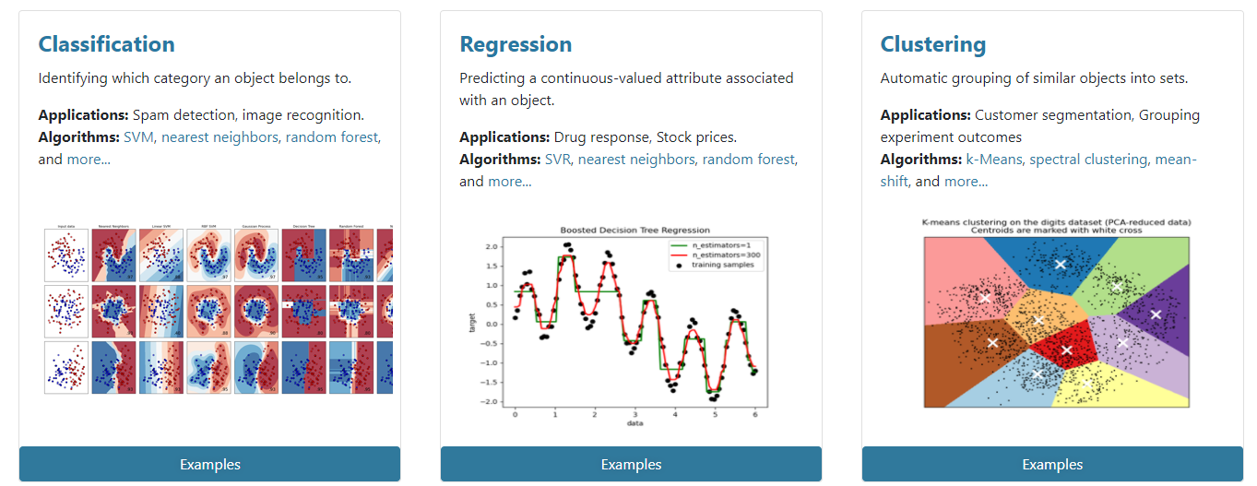





Course: Machine Learning in Python

Slide 6


Community
Slack NNF Computational Biology Network:
https://join.slack.com/t/nnfcbn/shared_invite/zt-piuxr1es-e08yRLg4iGNZTIBfjoPEjg
HeaDS: Center for Health Data Science
Building 33.4 in Panum – pass by, write, anything…

Slide 7


The Team
Alberto Santos (HeaDS)
Jose Alejandro Romero Herrera (HeaDS)
Davide Placido (NNF CPR)
Henry Webel (NNF CPR)
Philip Charles (BDI (Oxford, UK))
‪Rita Colaço (PRI)
Roc Reguant (NNF CPR)
Thilde Terkelsen (HeaDS)

Slide 8
Other Members of the Team
Annelaura Bach Nielsen (NNF CPR)
Dhouha Grissa (NNF CPR)
Grzegorz Jerzy Maciag (BRIC)
Katerina Nastou (NNF CPR)
Kübra Altinel (BRIC)
Marilena Hohmann (HeaDS)
Marta Matos (GENOME Center)
Nicholas Luke Cowie (DTU)

Slide 9
Thank You!

